Slide 1
Rocket launching site
Group Member-
1. Md. Nasir Uddin 011 142 128
2. Muhammad Saimoon Imran 011 142 153

Slide 2
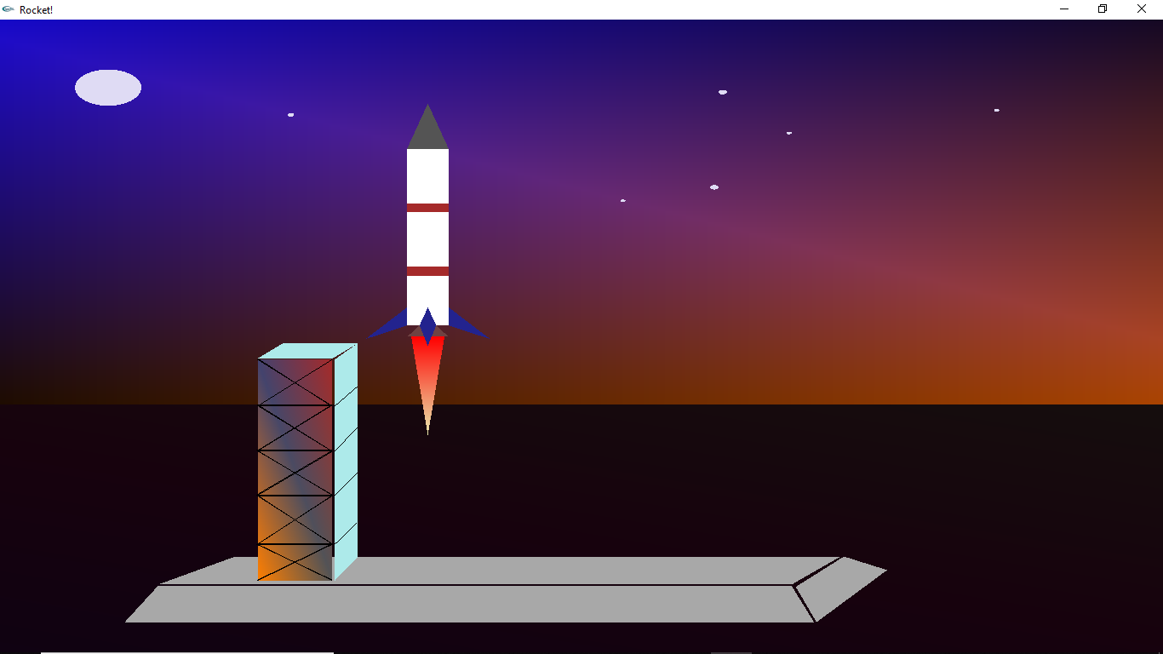

Slide 3
introduction
It’s an imaginary rocket launching site scenery.
We used some openGL functions to implement the whole scenery
GL_QUADS
GL_TRIANGLES
GL_LINES etc.

Slide 4
Tasks
Design a raw scenery on our notebook to determine how it would look like.
Try different color combination to make it look cool.
Determine the coordinates and write code for-
Sky
Moon & Stars
Rocket Tower
Rocket Body
Fire blowing after take off etc.

Slide 5
Thank you

